Slide 1


A Systems Approach
To Leading Literacy
Kelly Rivers, Academic Services Executive Director
Jen Ey, Director of Literacy
Notes:
Kelly and Jen
Good afternoon, we are pleased to present to you today on A System’s Approach to Leading Literacy.
As proud graduates of the school district where we serve, Columbus City Schools, we are particularly excited to share our story.
I am Kelly Rivers, the Executive Director of Literacy and Specialized Programming
And I am Jen Ey, Director of Literacy.

Slide 2

Today’s Objectives
District background
A snapshot of our literacy landscape
A timeline of curriculum implementation
Our systems approach to increasing literacy proficiency
Building a lasting MTSS infrastructure
Our significant growth and achievement
Resources
Questions
Notes:
Jen
Today we will
Provide some background of our district
Discuss our timeline for curriculum implementation
Provide details on our approach in developing and implementing a system to increase literacy achievement
Explain our MTSS infrastructure built on the Science of Reading
Discuss our significant growth and achievement
Provide resources and answer any questions you may have.

Slide 3



District Background

Slide 4

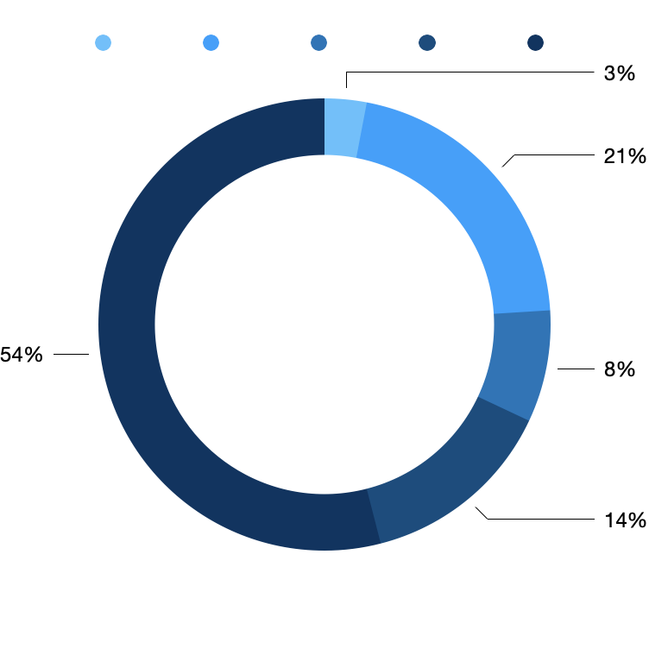


Our Scholars
The district’s diverse population of more than 45,000 scholars are a representation of the vibrant Columbus community.
Asian
White
Black
Multi-Racial
LatinX
Notes:
Jen
Columbus City Schools serves nearly 45,000 students in 112 school buildings.
We are a diverse district with 54% of our students being African American, 21% White, 14% LatinX, 8% Multi-Racial, and 3% Asian American.
We have specialized schools including: French Immersion and Spanish Immersion schools, a Gifted Academy, Online Academy, all girls school and an all boys schools, several STEM schools, and unique CTE programming.

Slide 5
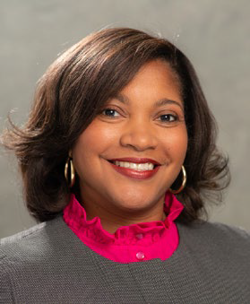
Our Superintendent
Champion for early literacy
Began her career in education as an elementary school teacher
Over 25 years of experience in public education
Credits her success to a strong belief that all students can and want to succeed
Proud parent of a CCS student
Dr. Angela Chapman
Superintendent/CEO
Notes:
Kelly
We are led by our Superintendent and CEO Dr. Angela Chapman. Who is a proud parent of Noble, a third grade student in Columbus City Schools, Dr. Chapman is a champion for early literacy.
She began her career in education as an elementary school teacher, serving students for over 25 years.
She credits her success to a strong belief that all students can and want to succeed.

Slide 6
Literacy Landscape

Slide 7

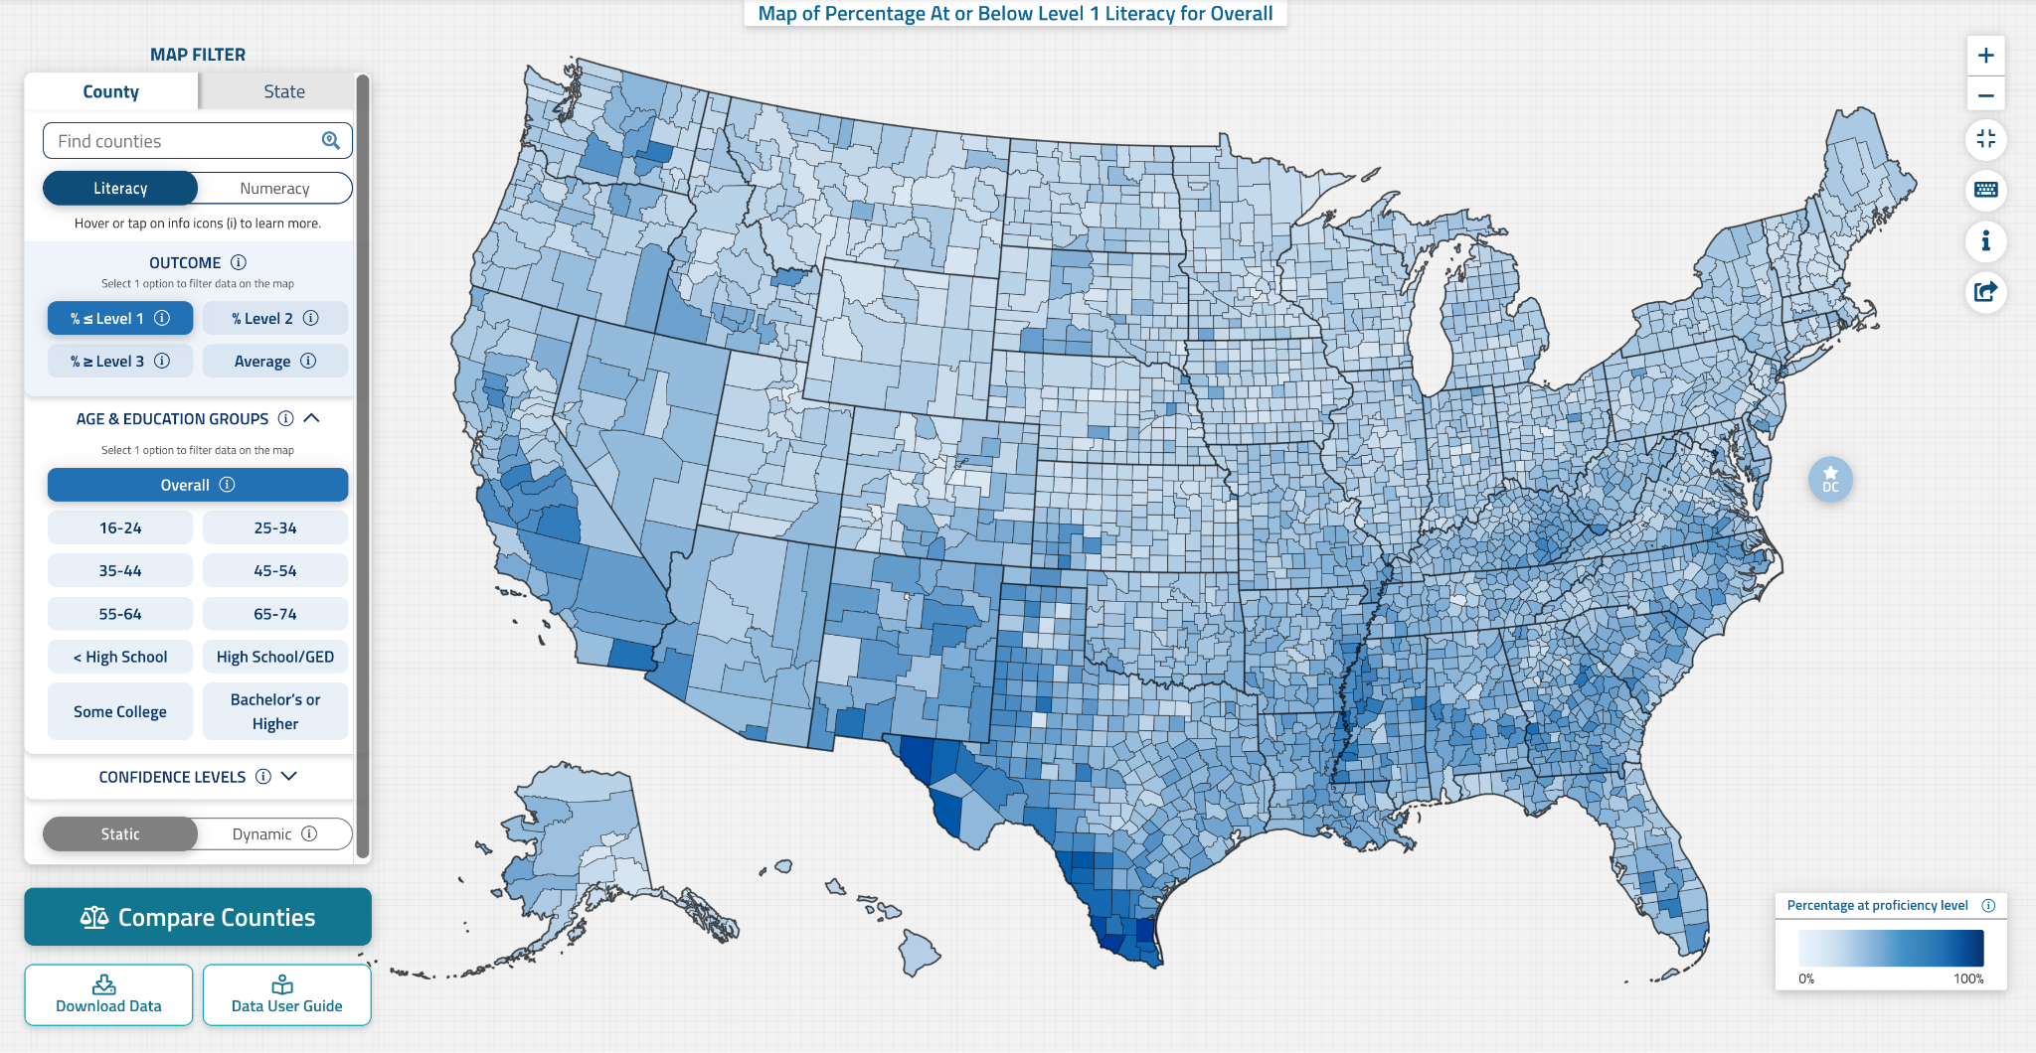
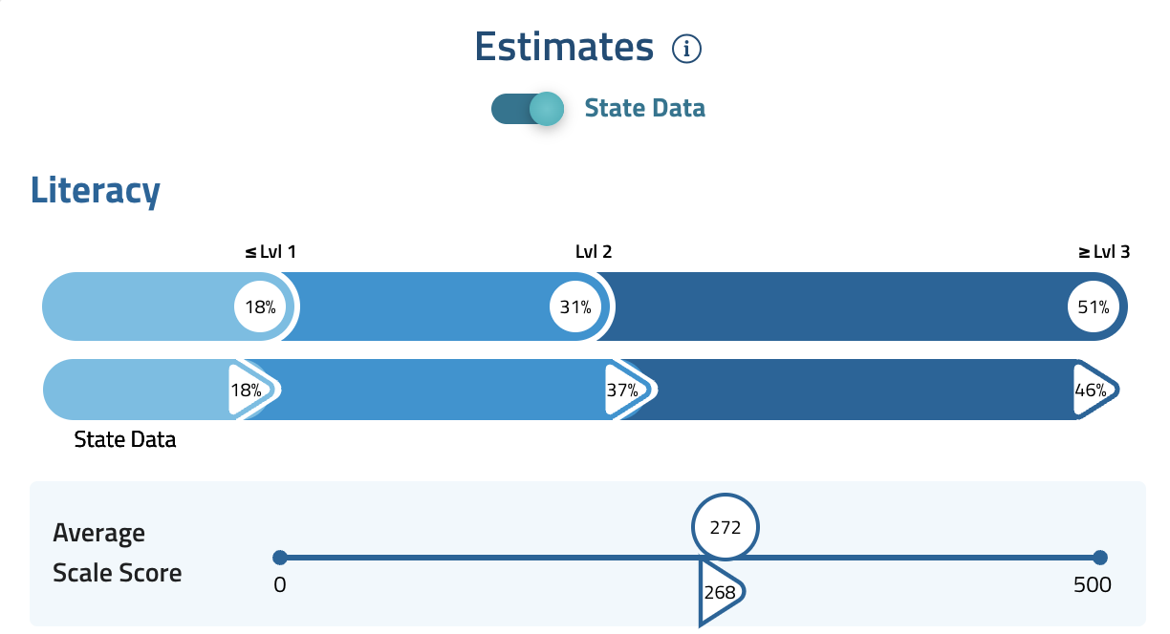
The Literacy Crisis
Some alarming statistics…
14% of adults are considered illiterate
21% of adults in the United States read below a 5th grade level
Half of adults who cannot read are unemployed
Students not reading by 3rd grade are 4x more likely not to graduate
Notes:
Kelly
In a world where we live and thrive in the information age, it is important that as stewards over the education of our students, we ensure all children have access to it.
Nearly 14% of adults are considered illiterate. Half of adults who cannot read are employed. This is an issue of economic access.
This decline can be predictive of outcomes, but the great news is it does not have to be.
We know the model for reading instruction that was widely used, did not account for explicit and systematic teaching of phonemic awareness and phonics in core instruction or intervention, contributing to the national decline in literacy achievement.

Slide 8
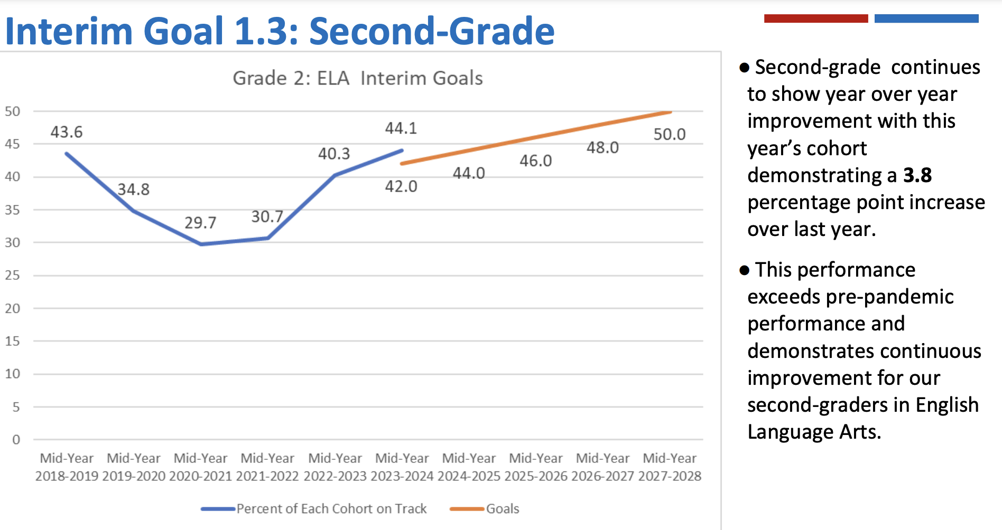
Literacy Results Prior to Implementation
A Snapshot of Second Grade
Notes:
Jen
We saw similar results in our school district. With early literacy indicators nearly being a predictor of economic disparities.
For example, nearly 80% of inmates in Ohio prisons are considered illiterate.
Living in a growing city with technology companies investing in our city such as Google, Intel, and Honda Battery it is critical that we change our narrative of literacy access in our community and it starts in our classrooms.

Slide 9
Root-Cause Analysis
Learning loss from the pandemic
The need for effective tier 2 and 3 interventions that solve for reading deficiencies
1
2
3
The need for explicit teaching of foundational skills
4
The need for alignment and clarity of tier 1 instruction
Notes:
Jen
Renowned expert in literacy, Timothy Shanahan states, 30 percent to 40 percent of kids will need the more explicit instruction that is part of the science of reading.
This is especially true for English Language Learners as the number of sounds and the way sounds are formed from language to language can vastly differ. The explicit teaching of these skills allows students to identify the sounds within the English Language and then connect those sounds eventually to words. Previous forms of instruction did not explicitly teach this transfer.
The pandemic has further intensified this literacy crisis, with decreased access to available teachers for both classroom, intervention, and specialized areas including special education and ESL.
Thus, requiring a shift in instruction through the explicit teaching of phonemic awareness and phonics in each tier of instruction.

Slide 10
The Need for Systems Change
According to Dr. Robert Swaim, Change Management Researcher, the need to change is usually brought about by concerns with or desired impact on one of the following six categories:
Crisis
Performance Gaps
Technology
Identification of Opportunities
Reaction to Internal and External Pressure
Mergers and Acquisitions
Systems change can be defined as shifting components or parts of a system — and the pattern of interactions between these parts — to ultimately form a new system that behaves in a qualitatively [and quantitatively] different way.
Notes:
Kelly
With this crisis we know that there is strong need for change. As a school district we can often experience all six concerns simultaneously. But we know waiting is not an option. Systems change must take place.Systems
Systems change can be defined as shifting components or parts of a system — and the pattern of interactions between these parts — to ultimately form a new system that behaves in a qualitatively [and quantitatively] different way.
Research shows that growth proceeds achievement. To increase literacy proficiency, there is no elevator, you have to take the stairs- incremental purposeful steps to increase the literacy health of the district, ensuring we have quality evidence-based literacy experiences inside and outside of the school walls
Next, we will highlight our aggressive plan to increase literacy achievement that incorporates all key stakeholders who impact our students daily.

Slide 11
Implementation Timeline

Slide 12
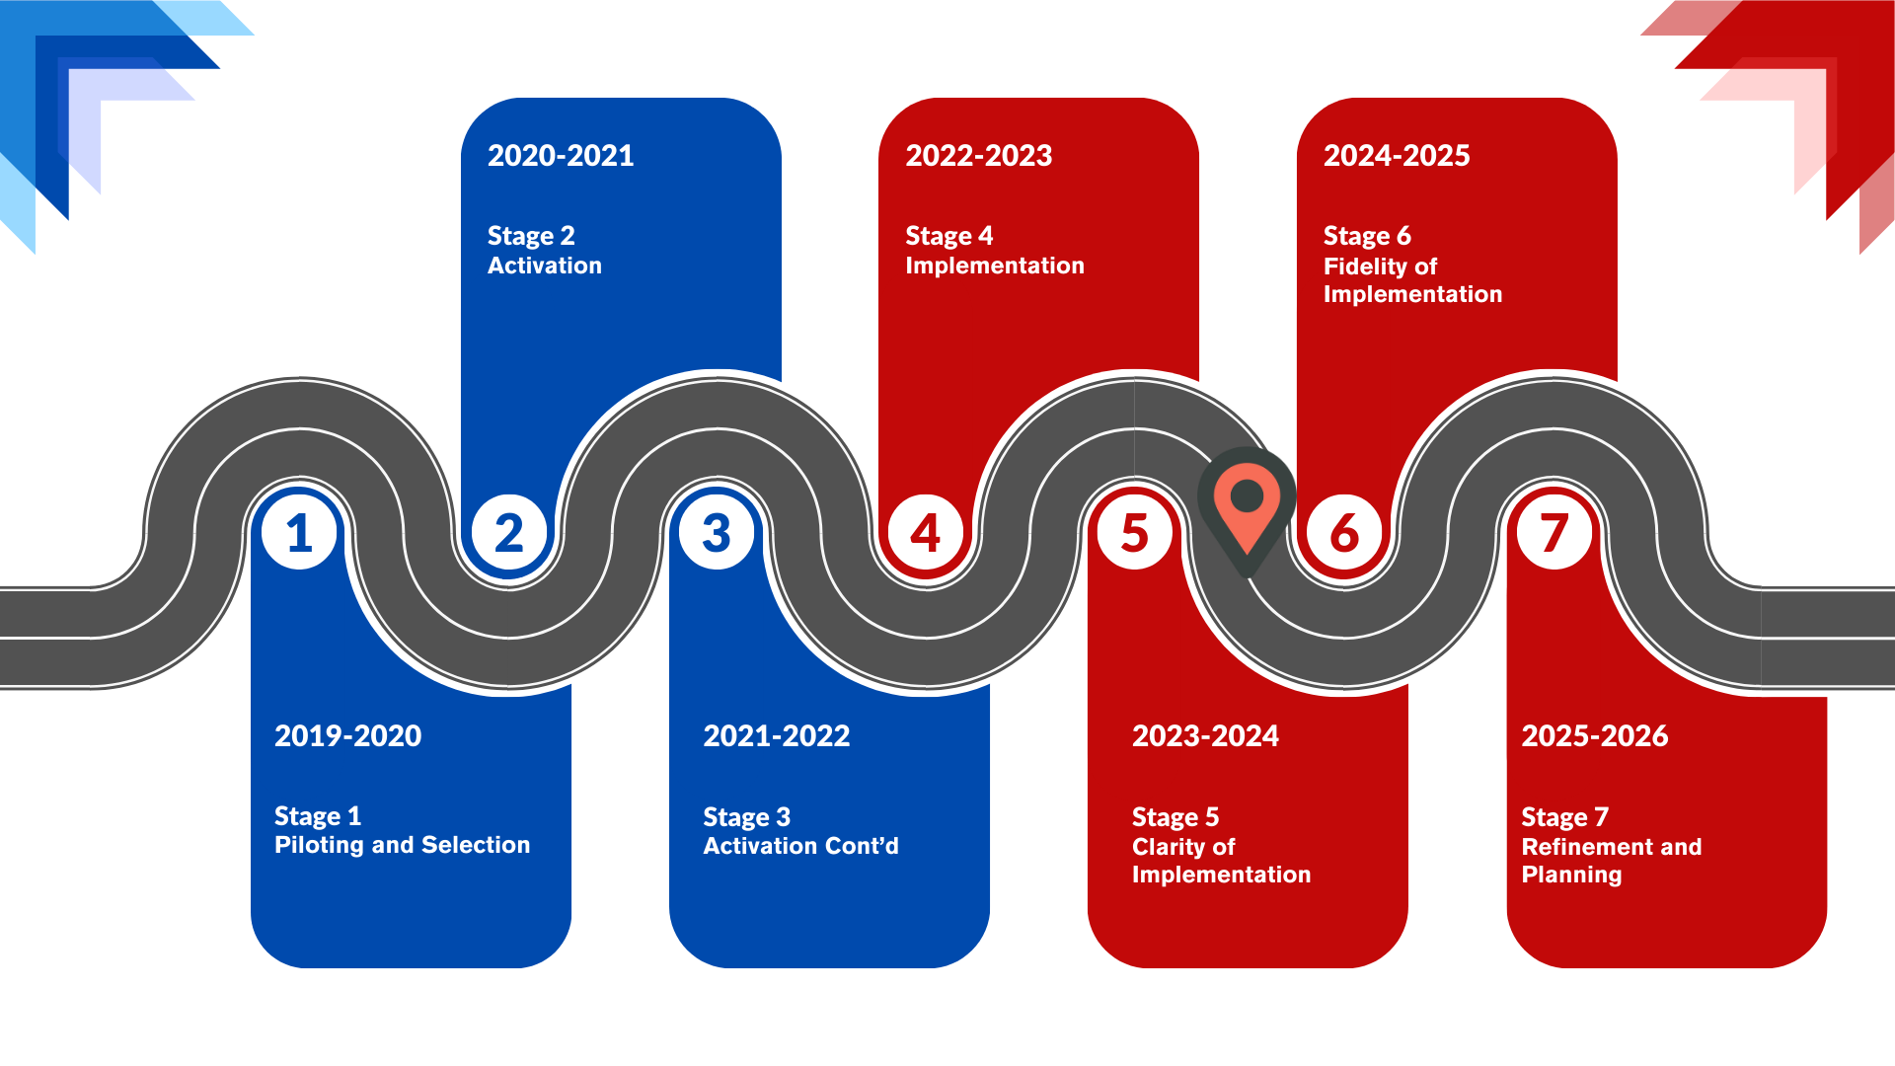
Curriculum Implementation Timeline
Notes:
Kelly
There is no elevator to success, you have to take the stairs.
We began our change process in the 2019 school year piloting and selecting our core curriculum. Our first year of implementation was during the 2020-2021 school year, in which we were remote for the first 2/3rds of the school year and staggered attendance for the remainder of that year.
We continued our activation years in the 2021-2022 school year and focused on implementing in 2022-2023 school year to include invaluable coaching support through HMH and Fundations.
This year our work is to focus on providing clarity in what is prioritized in each curriculum and and what is monitored. With concluding the last two years with fidelity of implementation and refinement and planning.

Slide 13
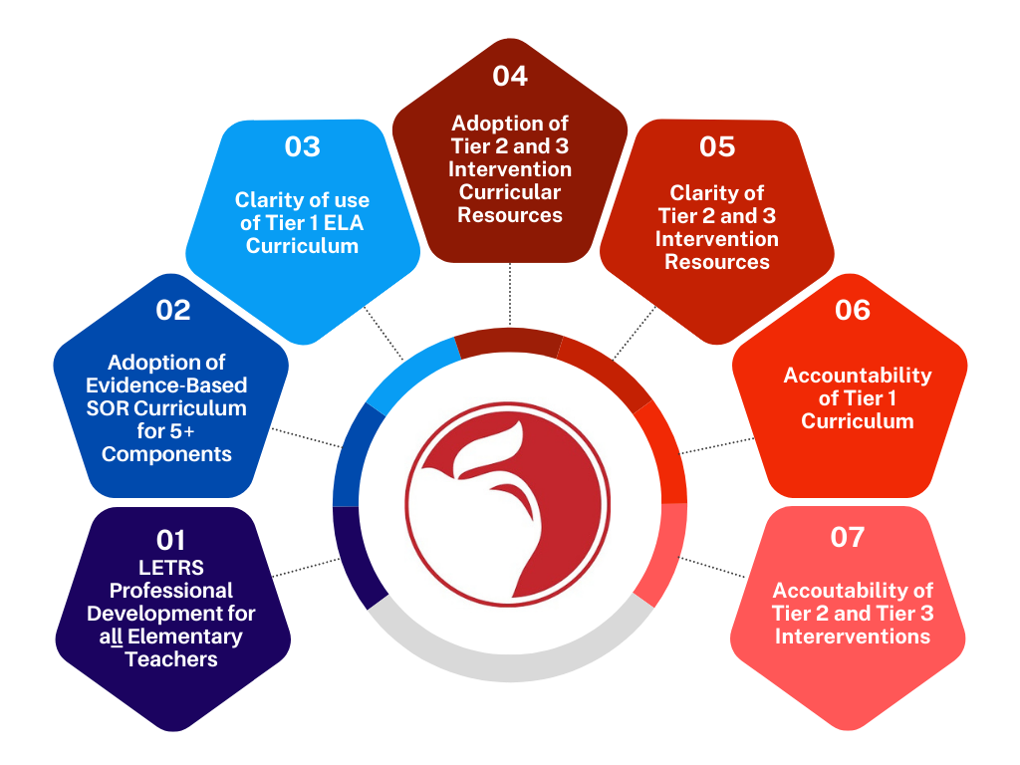
Curriculum Implementation Timeline
Notes:
Kelly
We have outlined 3 strategies to increase literacy achievement for students once they enter our doors as exciting new Kindergartners.
Professional Development rooted in evidence-based strategies for each teacher of literacy focus on all critical areas of literacy including: phonological awareness, phonics, fluency, vocabulary, comprehension, and writing.
Clarity in instruction at each tier for each of these areas to ensure our children are best equipped for all of the opportunities available before them
Quality literacy resources and supports for families and community partners aligned to the Science of Reading
We will go into more detail about these strategies in the next few slides- covering what we are doing, what is working well, and what areas we are still working to improve.

Slide 14
Our Systems Approach

Slide 15
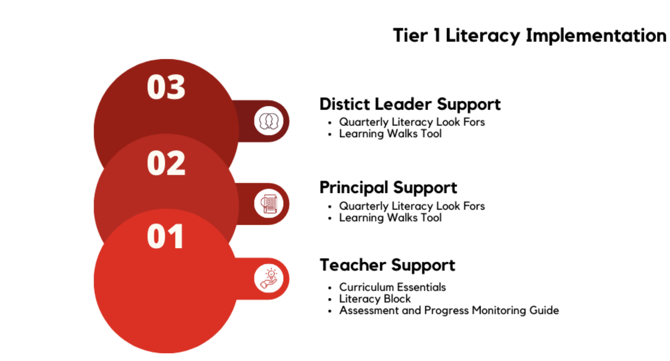
Curriculum Implementation: Stage 5
Notes:
Jen
With over 10 million dollars dedicated to the purchase of high quality curriculum, it is vital that we ensure we are using the district adopted curriculum and further examine additional ways to show mastery. The continual monitoring of student mastery coupled with the consistent use of evidence-based curriculum and providing opportunities for reteaching and spiraling, will position our students with the essential literacy skills they need in school and beyond.
While we adopted quality tier 1 instructional materials aligned to the Science of Reading three years ago, we found that a shift in instruction required clarity of what to use, when , and how.
Through a cross-departmental team, we developed essential documents to help teachers prioritize teaching- as tier 1 consists of 3 curriculum materials.
This new resource provides teachers clarity in the scope and sequence for each quarter and is aligned to our Look For document for coaches and content leads to support implementation. The Learning Walks Tool designed for principals, provides them specific skills to monitor implementation (which I will discuss in a few slides), so that we are monitoring and supporting the curriculum in real time.
This allows us to provide immediate support when and where needed.
District level support (including area superintendents, coaches, members of the Academic Services team, the whole child department and the department of equity utilize this same tool when conducting visits, and will use the feedback to better support schools when and where needed.

Slide 16
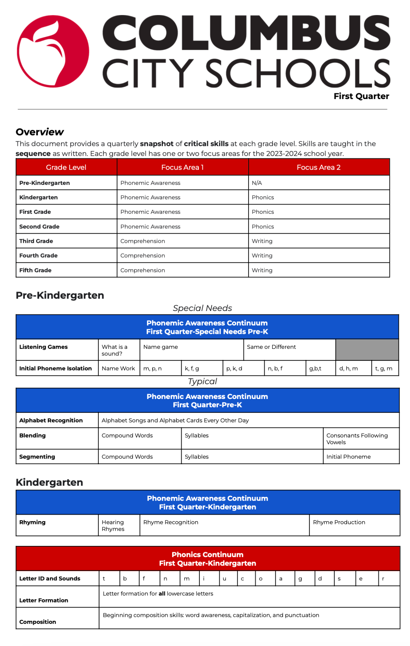
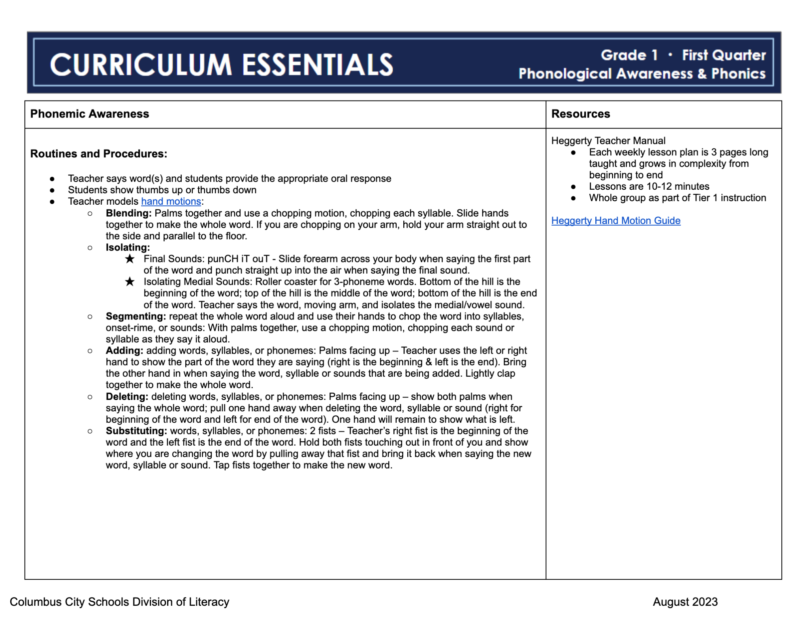
Curriculum Implementation: Stage 5
Teacher Support ->Coach Support
Notes:
Jen
We begin our focus on clarity of implementation by providing teachers our Curriculum Essentials document, which prioritizes our 3 curriculum resources by quarter for each grade level. This document highlights the critical skills taught in each module of learning.
We then prioritize the skills we monitor in our classrooms, focusing on phonological awareness and phonics in grades Pre-K-2 and writing and comprehension in grades 3-5. Our team highlights the critical skills for our building coaches to better support teachers in the sequence that these skills are taught.

Slide 17
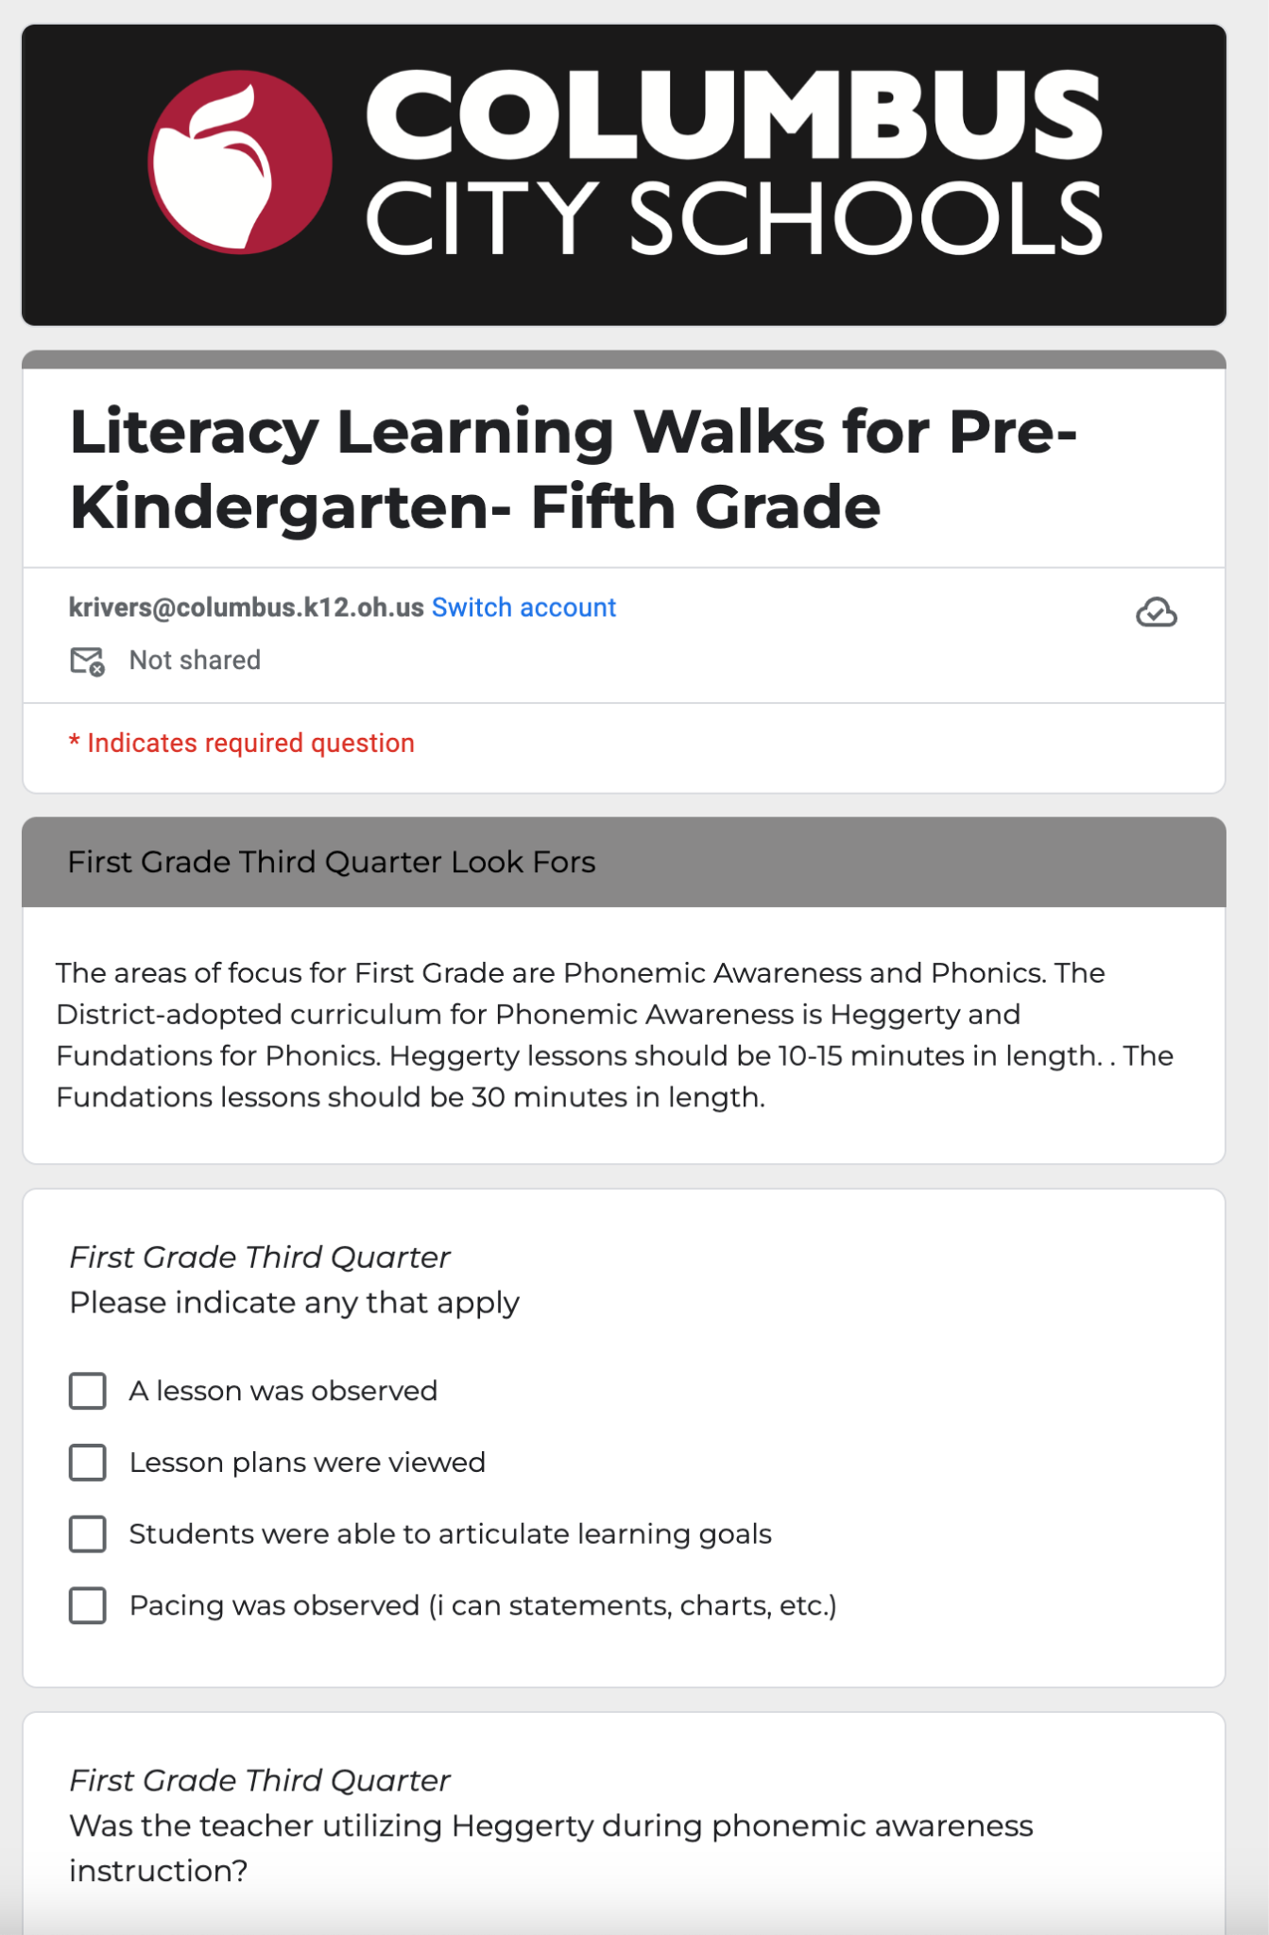
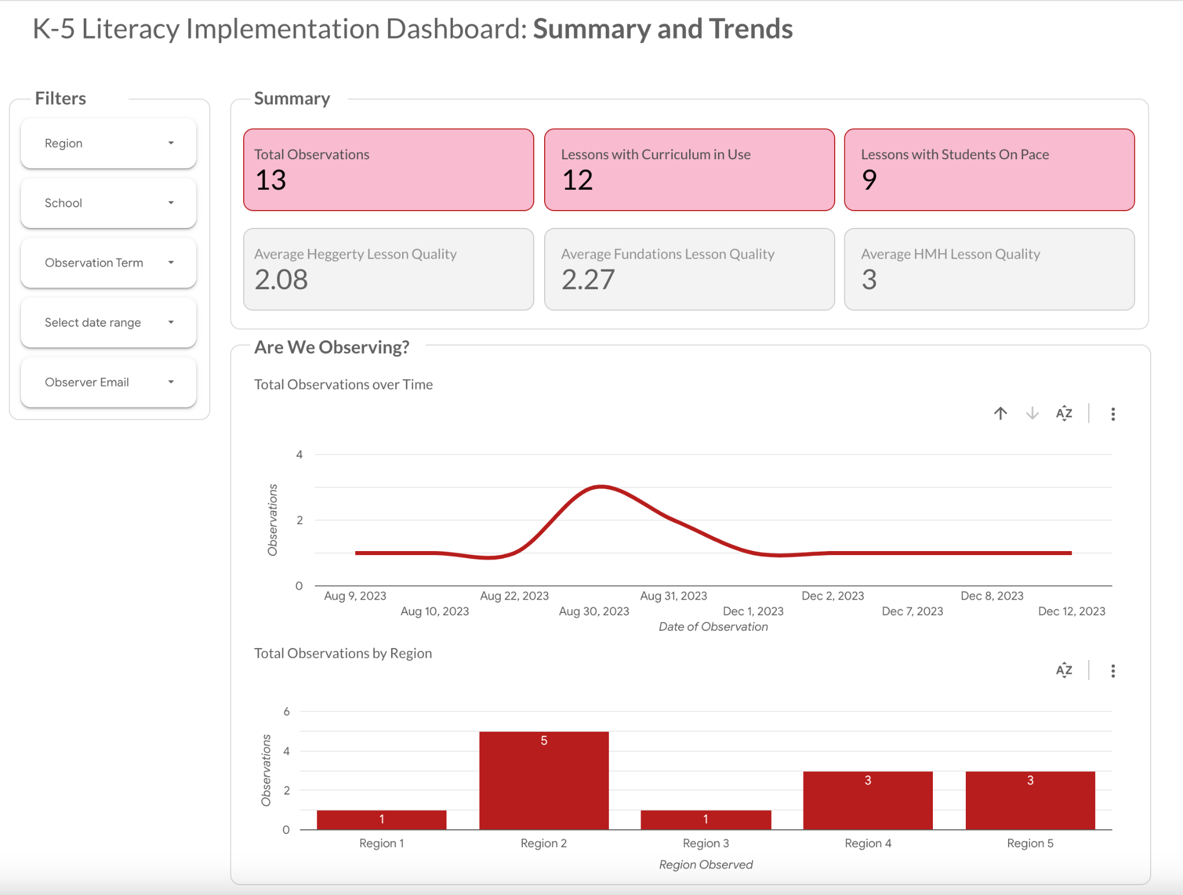
Curriculum Implementation: Stage 5
Building Leader ->District Support
Notes:
Jen
Principals then conduct learning walks by visiting classrooms and determining the level of implementation that is occurring. This is through the Look Fors Document- key skills to monitor each quarter.
The ratings of implementation are then accumulated in our CCS Literacy Dashboard. This allows us to dispatch support when needed.

Slide 18
Building a Lasting MTSS Infrastructure

Slide 19

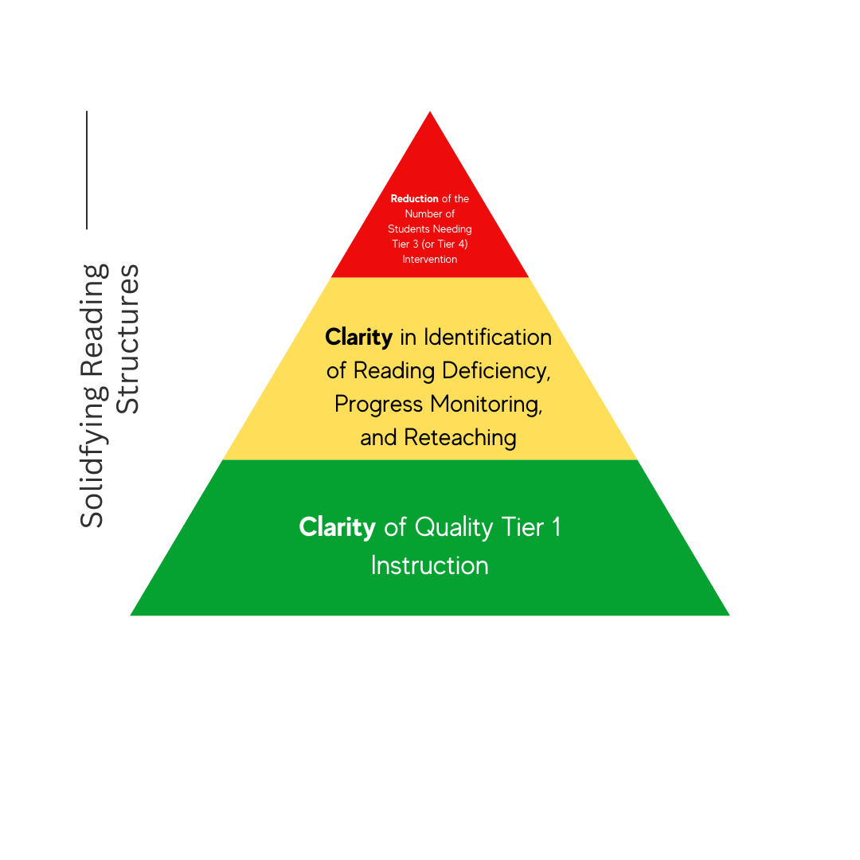
The Need to “Flip the Script”
x
Notes:
Jen
As previously mentioned, there is a national concern about the declining rate of literacy. We find these same concerns within our district. Many times, our building leaders are faced with literacy data that models an inverted triangle, where most students require tier 2 or tier 3 intervention,
When this occurs, research shows that it is a tier 1 concern- meaning that students are not accessing quality grade level materials. A longitudinal study released by the US Department of Education, spanning 15 years found that “Identifying Tier 1 reading instruction that benefits most students is critical to the successful implementation of multi-tiered systems and meeting a diverse range of student learning needs.”

Slide 20
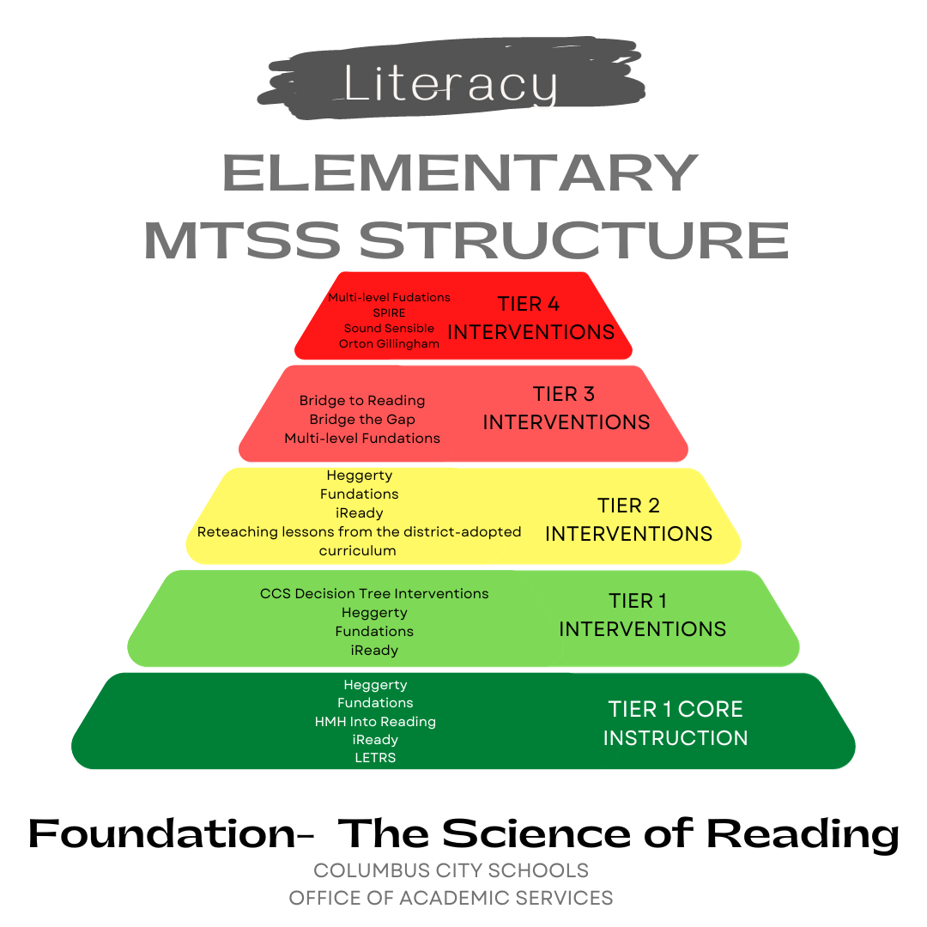
Increasing Literacy Achievement
Focus on high impact literacy strategies at critical years in child development
  Phonemic Awareness- Heggerty
  Phonics- Fundations
  Fluency- Fundations/Geodes
  Vocabulary-HMH Into Reading
  Comprehension- HMH Into Reading
  Writing- HMH Into Reading
Notes:
Jen
Similar to tier 1, there is a need to provide clarity in tier 2 and tier 3 interventions.
Classroom teachers, as required by the Reading Improvement Monitoring Plan (RIMP), provide 30 minutes of reading intervention, as required by law.
As previously mentioned, in literacy, many of our schools are faced with an inverted triangle. Providing clarity in tier 2 and tier 3 intervention allows for the natural alignment to the Science of Reading using evidence-based strategies and moves us from compliance to action that leads to increased literacy achievement.

Slide 21
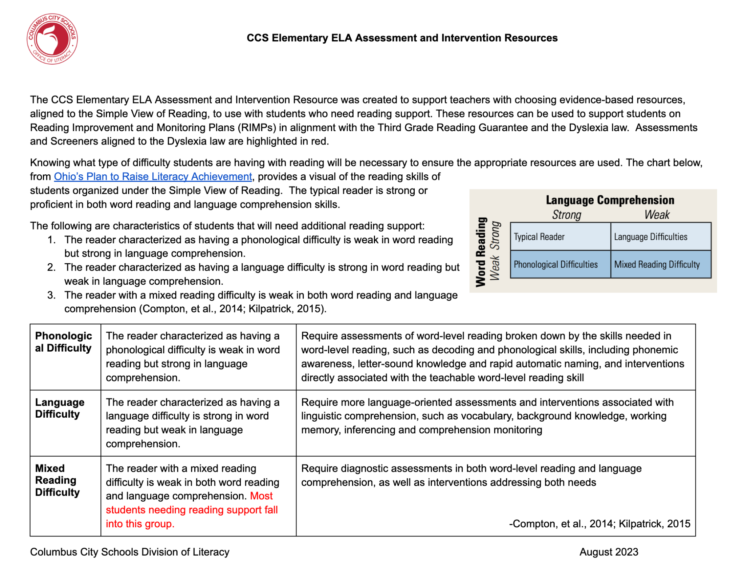
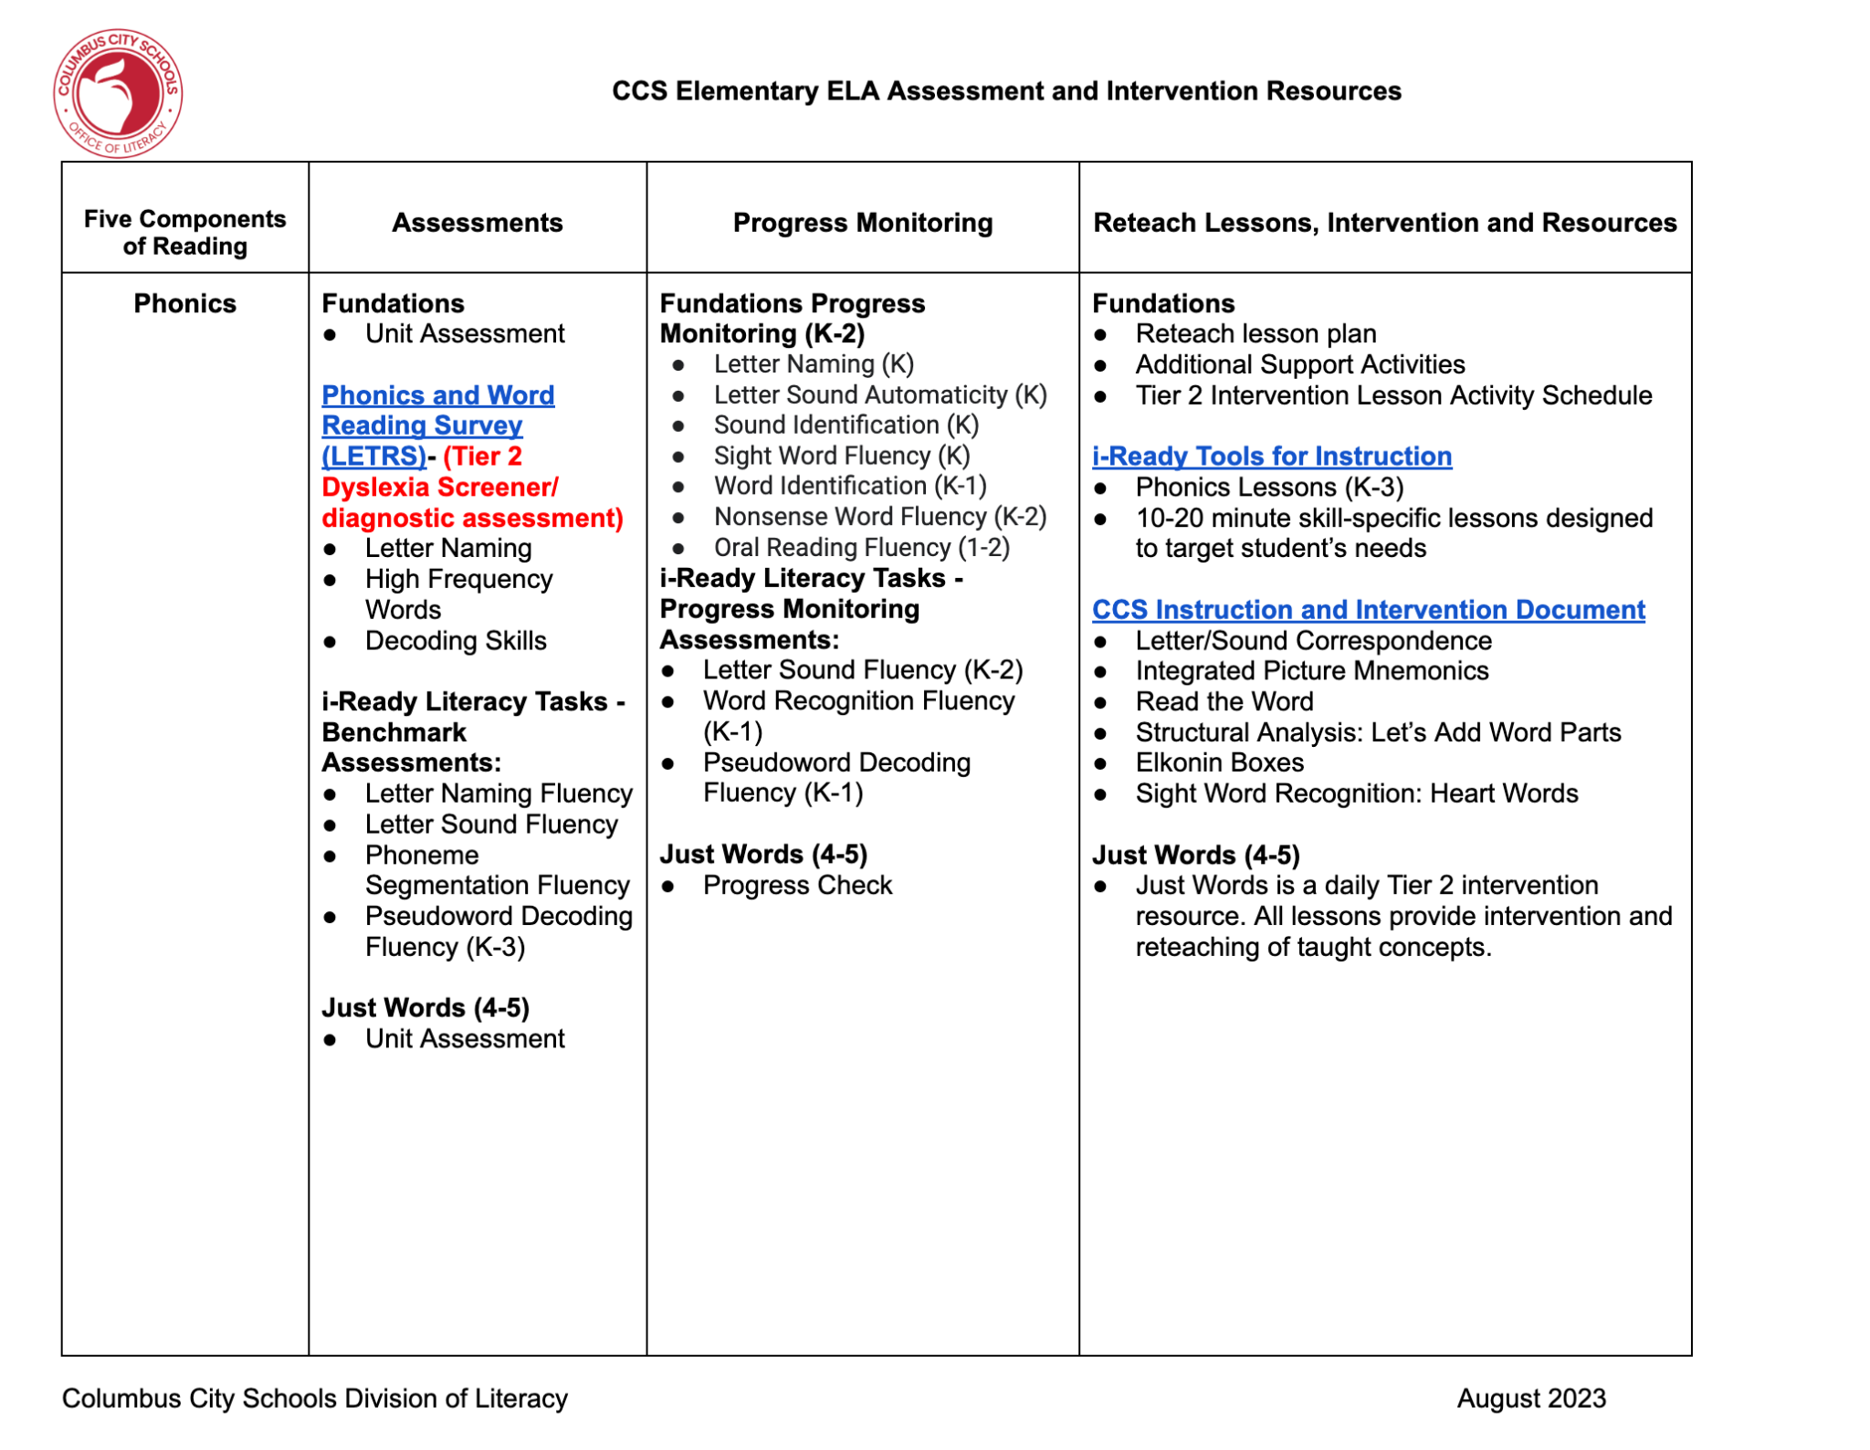
MTSS Tier 2 and Tier 3 Support
Notes:
Jen
Through the development of our Assessment and Progress Monitoring resource, we provide teachers clarity on what evidence based strategies should be utilized, how to intervene, and what to use to progress monitor growth.
Providing this clarity for our students and ensuring that evidence-based strategies aligned to their most urgent literacy need, will decrease the number of students requiring tier 2 and tier 3 intervention over time.
The National Library of Medicine did a meta analysis of literacy interventions and health, and found that the use of evidence- based multi-tiered interventions in reading has shown overall improvements in reading outcomes for participating students, as well as evidence that the incidence of reading disability may be reduced, particularly for students in kindergarten and first grade.. This support can benefit both the academic and physical health of the student.

Slide 22
Literacy Growth and Achievement

Slide 23
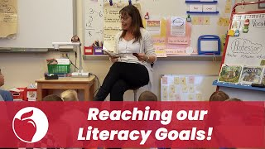
Notes:
Kelly

Slide 24
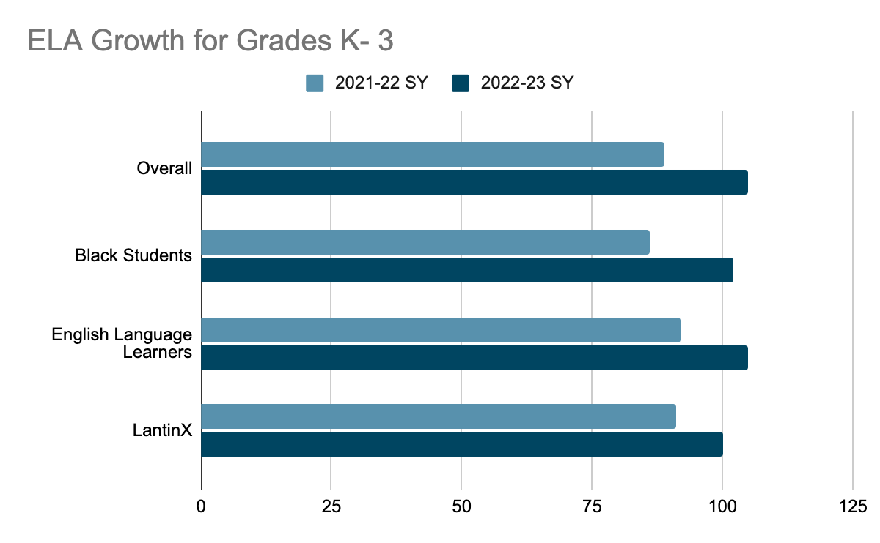
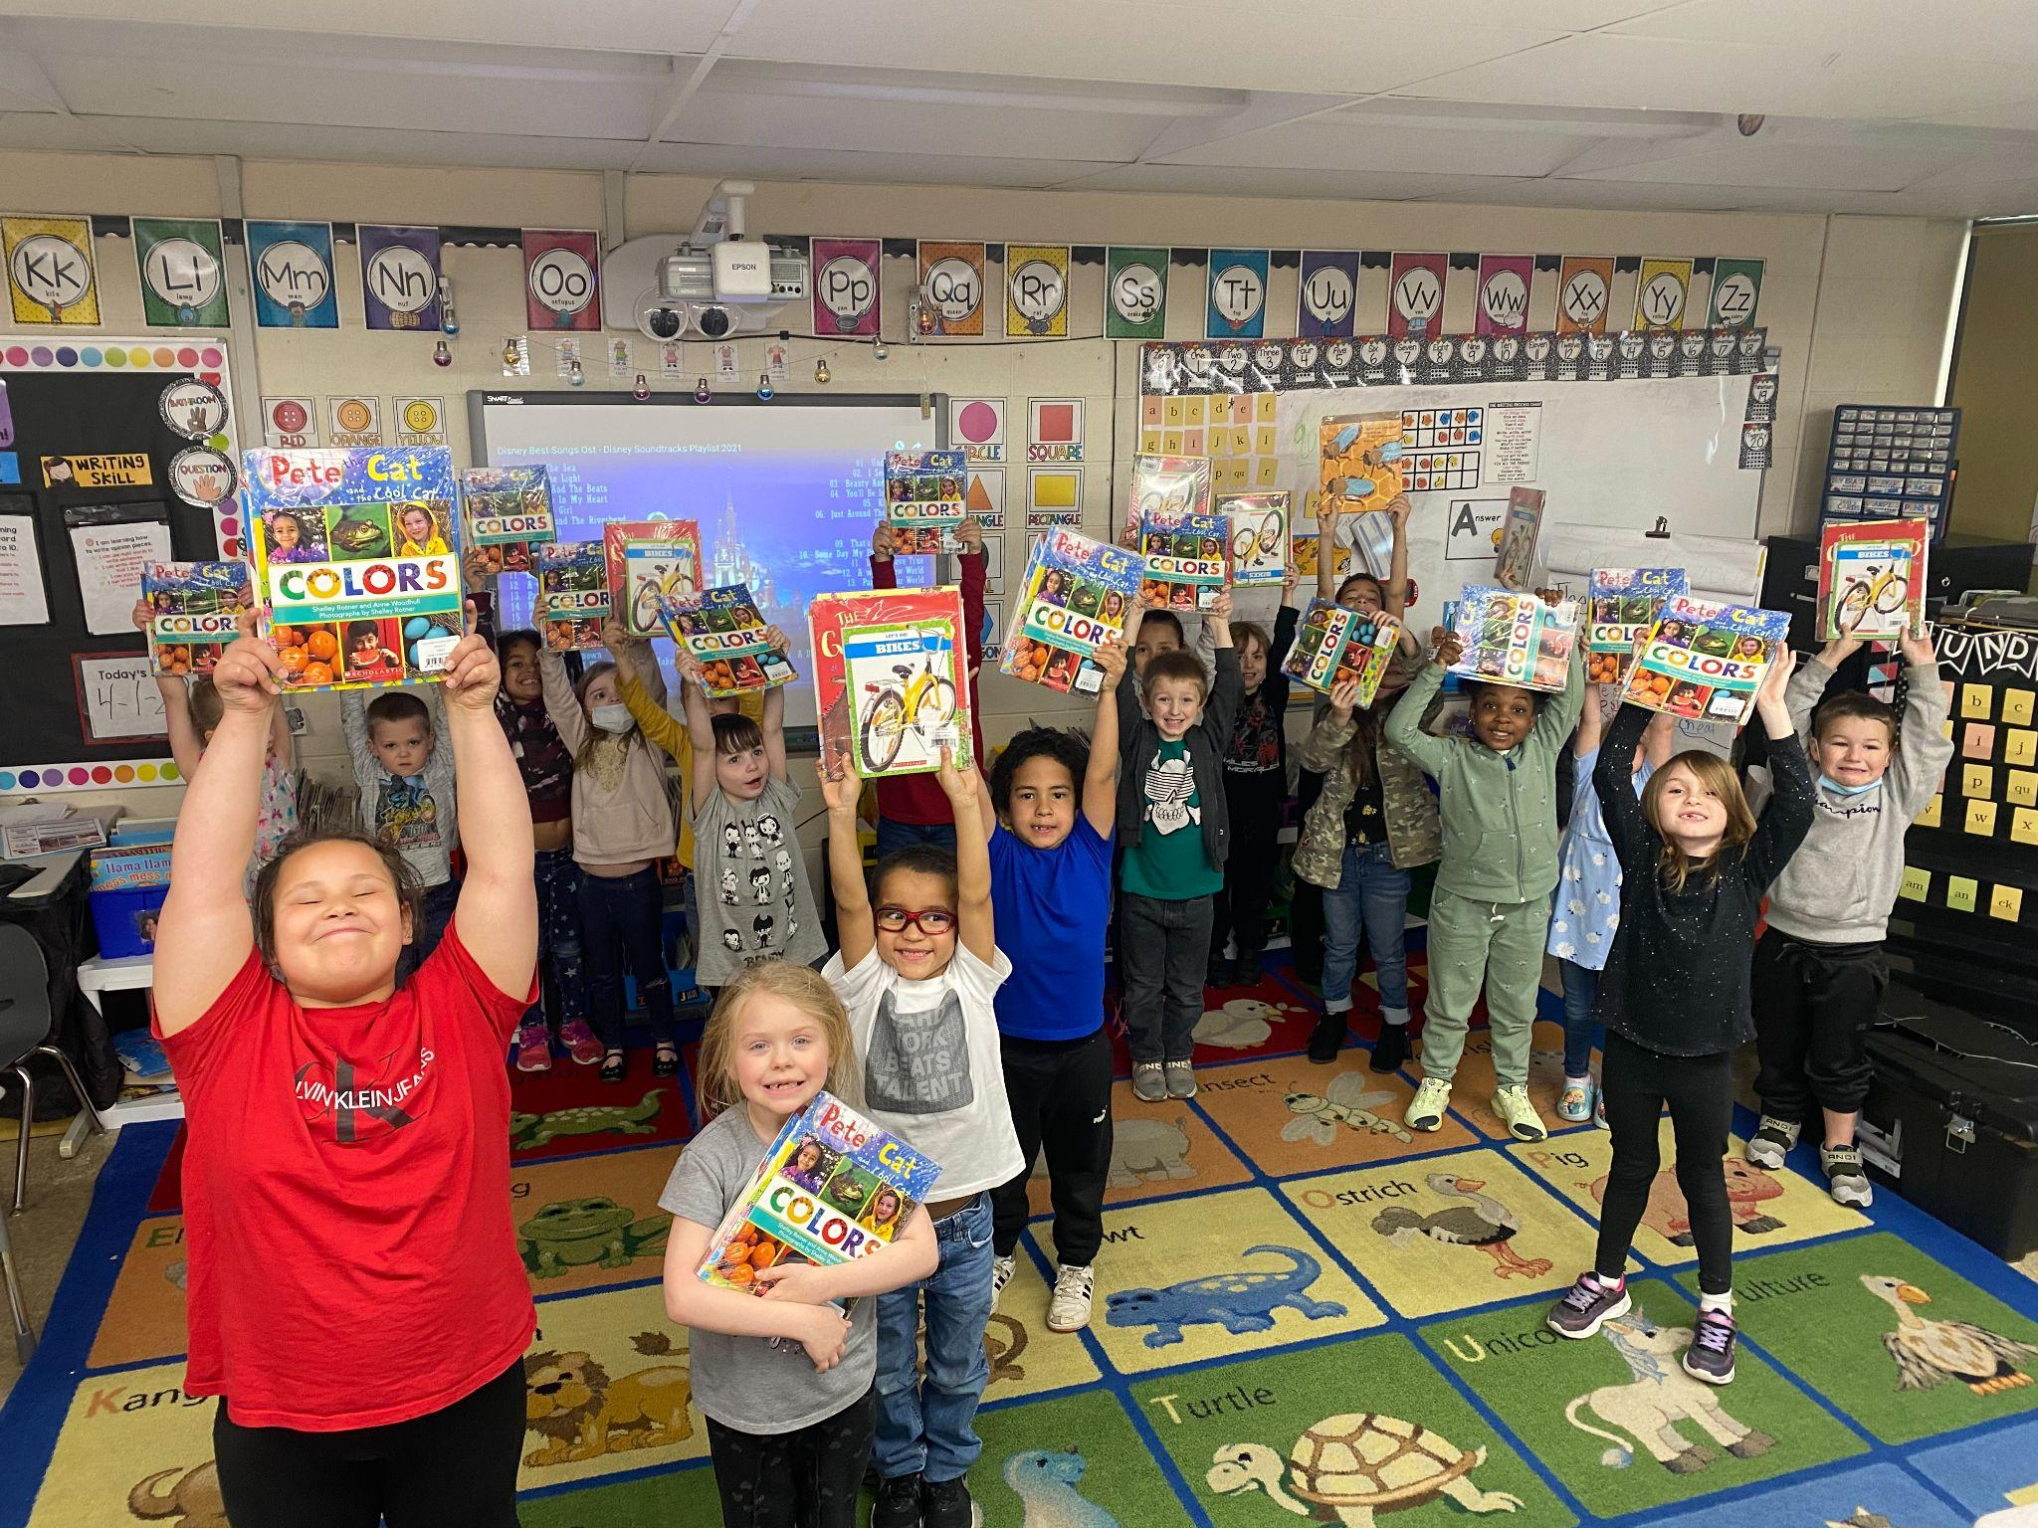
Literacy Growth
Notes:
Kelly
With this targeted plan, we are already seeing results that are defying national trends..
As previously stated, growth proceeds achievement, and we are aggressively addressing performance gaps through the accelerated growth of our students
89% growth (2021-22 SY) to 105% (2022-2023) for all students
86% growth (2021-22) SY to 102% (2022-2023) for black students
92% growth (2021-22) to 105%(2021-22) for ELLs
91% growth (2021-22) to 100% (2021-22) for LatinX students
We are now seeing results on state assessments.
Third grade students' achievement on state assessments has increased by 11% over the past 2 years.
Our most recent third grade reading data from the fall administration of the Ohio State Test showed an increase of nearly 7% from the previous year.

Slide 25
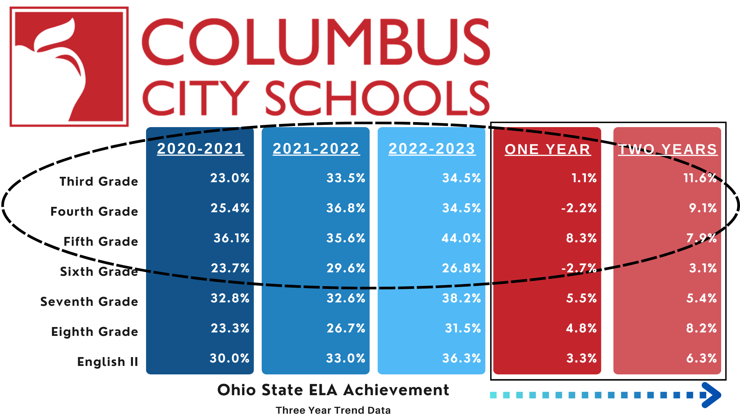
Literacy Achievement
Notes:
Kelly
Through these efforts we have seen gains in all grade levels in ELA since the 2020-2021 school year. Additionally, we have made substantial growth (of a larger magnitude), as indicated on our state report card for all tested grades in ELA.

Slide 26
Resources

Slide 27
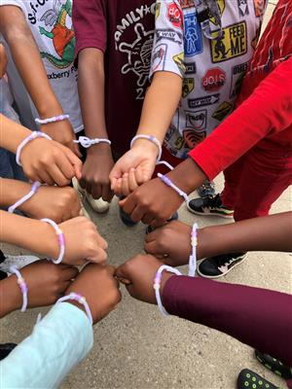
Resources
CCS Landing Page
Science of Reading Podcast
CCS Literacy Infographic
NCTE Council Article
YouTube Videos
  Developing Strong Readers
  At Home Library Initiative
  CCS Pathway Events
  Bookelicious
  Summer Learning Kits
Family Engagement Pamphlet on the Science of Reading
Family Resource Brochure
Notes:
Jen
There are so many wonderful things to share in such a short time. As a literacy department we provided over 2 million books to families, purchased over 40,000 individually selected books for children in grades K-5, and provided e-book access to all children in K-12.
Over 75% of our students stated that they are now motivated to read for pleasure, when previously less than 30% stated they were motivated to read for pleasure.
Our families have written emails expressing their gratitude for providing this access. Here is one written to me that I would like to share:
My name is Leslie MacColman, and my daughter is a first-grader at the Columbus Spanish Immersion School. I got your email from the CSIA principal, Ashley Beasley.
Yesterday, we got another package of books from CCS, which prompted me to send a message I've been meaning to send for a while. Basically, what I want you and your colleagues to know is that OUR FAMILY LOVES THE BOOKS YOU SELECT! They're thematically and artistically varied, age-appropriate, and, importantly, they represent and celebrate many races, cultures, and lived experiences. They help my daughter make sense of the world around her and what she experiences at school and at home in ways that a different collection of books would not.
One example that comes to mind is a book that was sent in the Fall (I think) that was about leaders/ dreamers, like MLK, Ruth Bader Ginsburg, etc. My daughter specifically asked to read it after MLK day this year because she wanted to talk about what he did and why it was important. Another example that comes to mind is a book about a young Vietnamese-American boy and his grandfather, who have a language barrier but communicate via drawings. My d
aughter's grandparents speak another language (Spanish) so she can relate to the boy in the book, and we've read it many times (also because the illustrations are stunning). For a while, my other daughter (age 3) was obsessed with the book Charlie Parker Plays Bebop. These are just a few of the many examples I could share.
Anyway, I just wanted to say thank you. And keep doing what you're doing. Our family appreciates the selection, and I'm sure we're not alone.
This is why we do what we do.
Now we will take any questions you may have.

Slide 28
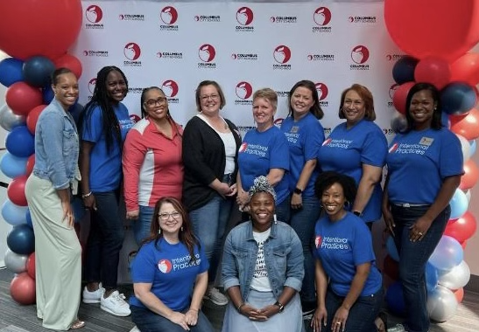
Questions?
The CCS Literacy Team

